Slide 1
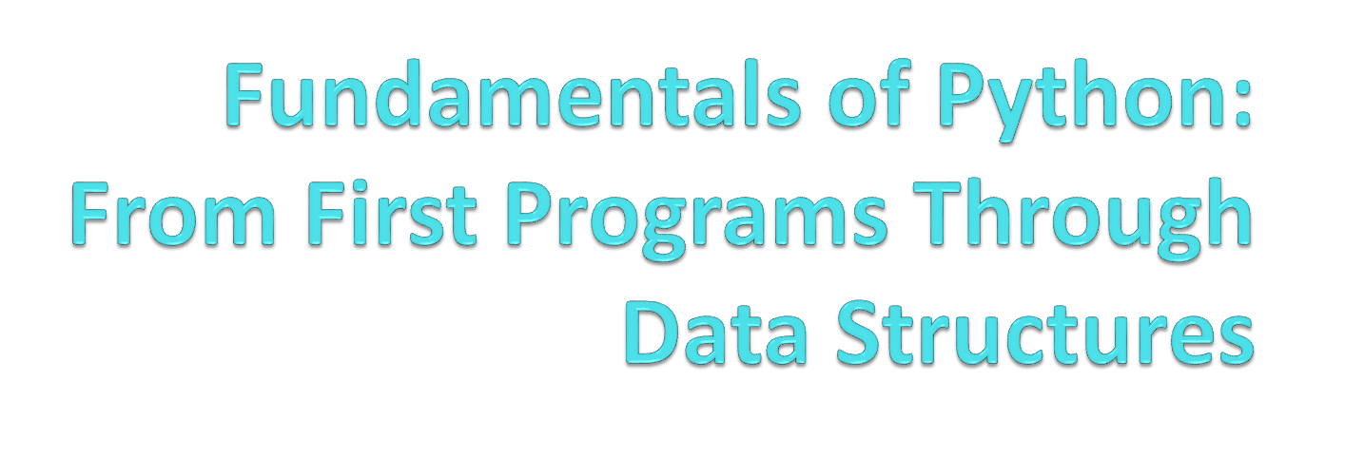
Chapter 2
Software Development, Data Types, and Expressions

Slide 2
Objectives
After completing this chapter, you will be able to:
Describe the basic phases of software development: analysis, design, coding, and testing
Use strings for the terminal input and output of text
Use integers and floating point numbers in arithmetic operations
Construct arithmetic expressions
Initialize and use variables with appropriate names
Fundamentals of Python: From First Programs Through Data Structures

Slide 3
Objectives (continued)
Import functions from library modules
Call functions with arguments and use returned values appropriately
Construct a simple Python program that performs inputs, calculations, and outputs
Use docstrings to document Python programs
Fundamentals of Python: From First Programs Through Data Structures

Slide 4
The Software Development Process
Software development: process of planning and organizing a program
  Several approaches; one is the waterfall model
Modern software development is usually incremental and iterative
  Analysis and design may produce a prototype of a system for coding, and then back up to earlier phases to fill in more details after some testing
Fundamentals of Python: From First Programs Through Data Structures

Slide 5
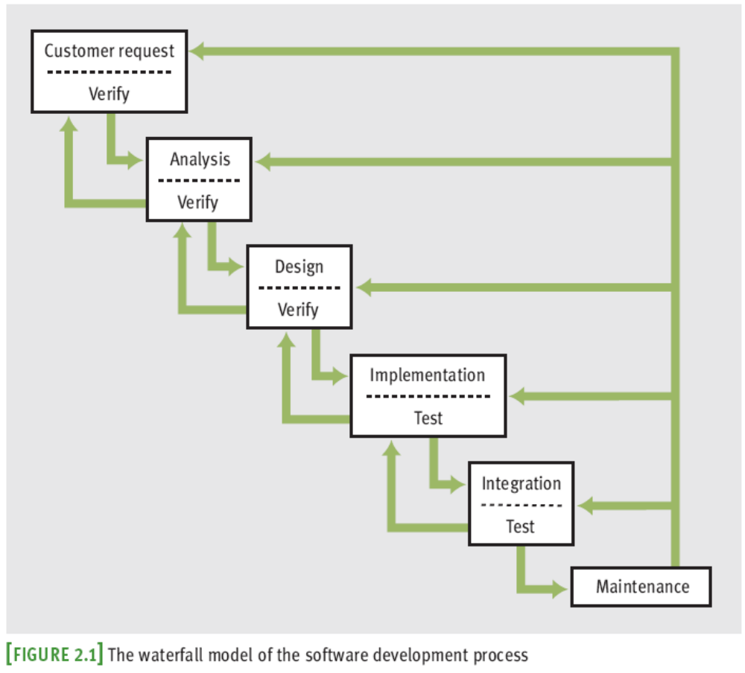
The Software Development Process (continued)
Fundamentals of Python: From First Programs Through Data Structures

Slide 6
The Software Development Process (continued)
Programs rarely work as hoped the first time they are run
  Must perform extensive and careful testing
Fundamentals of Python: From First Programs Through Data Structures

Slide 7
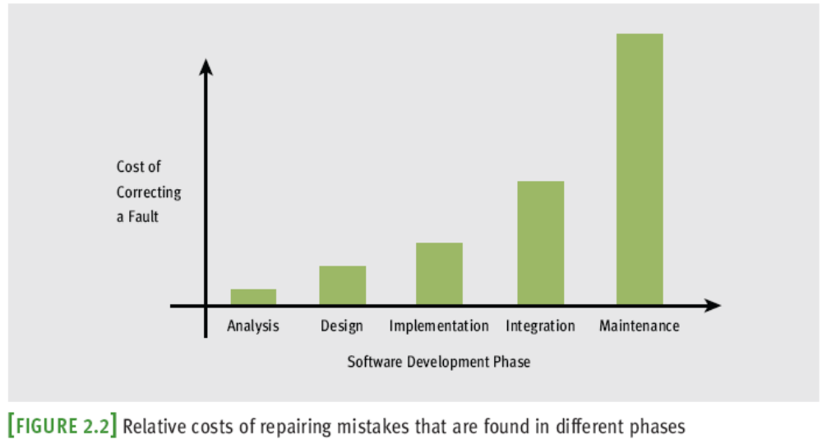
The Software Development Process (continued)
Fundamentals of Python: From First Programs Through Data Structures

Slide 8
The Software Development Process (continued)
The cost of developing software is not spread equally over the phases
Fundamentals of Python: From First Programs Through Data Structures

Slide 9
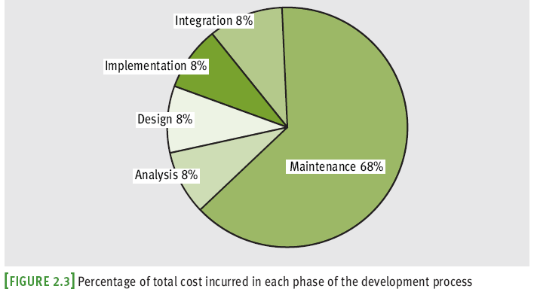
The Software Development Process (continued)
Fundamentals of Python: From First Programs Through Data Structures

Slide 10
Case Study: Income Tax Calculator
Each year nearly everyone with an income faces the unpleasant task of computing his or her income tax return
If only it could be done as easily as suggested in this case study
We start with the customer request phase
Fundamentals of Python: From First Programs Through Data Structures

Slide 11
Case Study: Request
The customer requests a program that computes a person’s income tax
Fundamentals of Python: From First Programs Through Data Structures

Slide 12
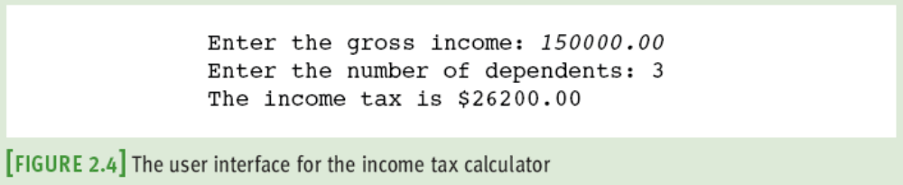
Case Study: Analysis
All taxpayers are charged a flat tax rate of 20%
Taxpayers are allowed $10,000 standard deduction
For each dependent, taxpayer is allowed additional $2000 deduction
Gross income must be entered to nearest penny
Income tax is expressed as decimal number
Fundamentals of Python: From First Programs Through Data Structures

Slide 13
Case Study: Design
Algorithms are more often written in a somewhat stylized version of English called pseudocode
Pseudocode for our income tax program:
  Input the gross income and number of dependents
  Compute the taxable income using the formula
  Taxable income = gross income - 10000 - (2000 * number of dependents)
  Compute the income tax using the formula
  Tax = taxable income * 0.20
  Print the tax
Fundamentals of Python: From First Programs Through Data Structures

Slide 14
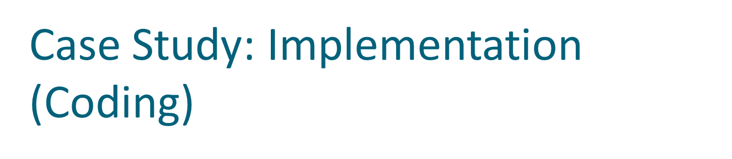
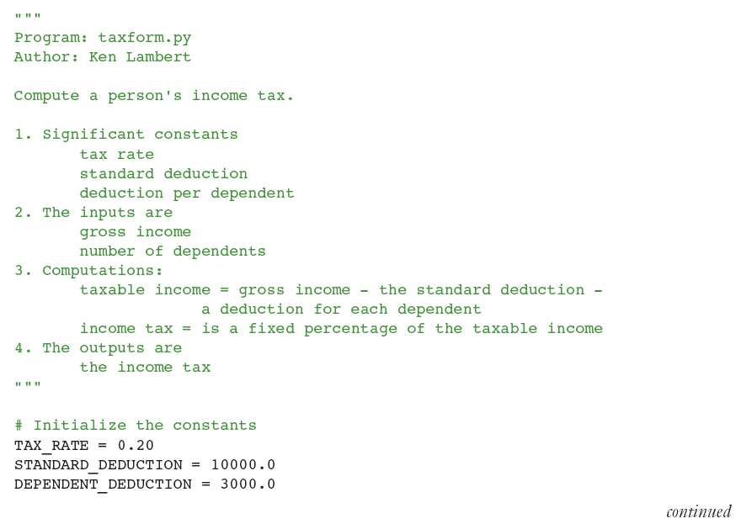
Fundamentals of Python: From First Programs Through Data Structures

Slide 15
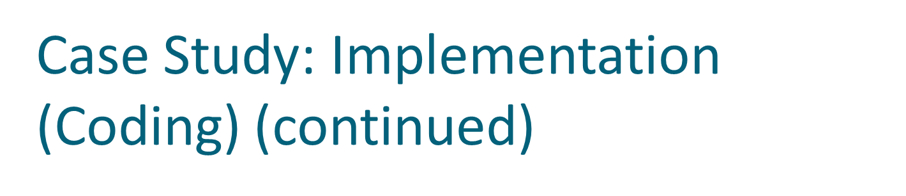
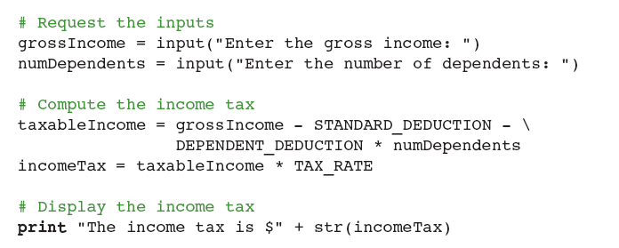
Fundamentals of Python: From First Programs Through Data Structures

Slide 16
Case Study: Testing
Even if there are no syntax errors, the program could still have a logic error or a design error
May use a test suite to test if program is correct
Fundamentals of Python: From First Programs Through Data Structures

Slide 17
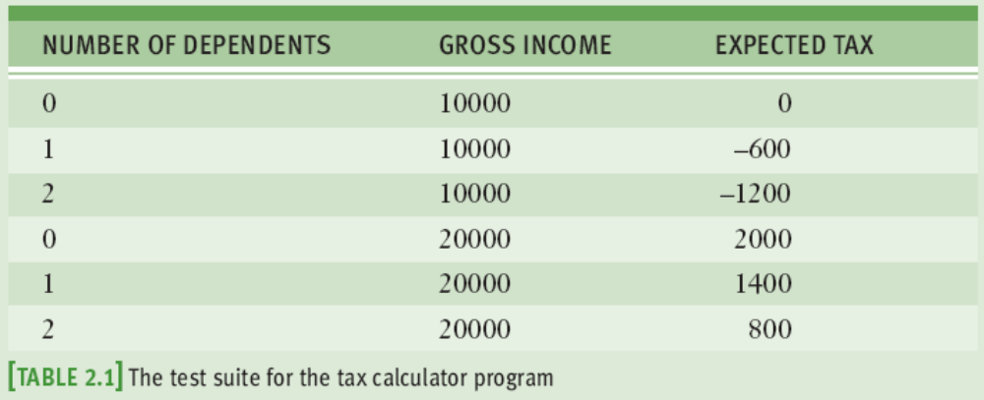
Case Study: Testing (continued)
Fundamentals of Python: From First Programs Through Data Structures

Slide 18
Strings, Assignment, and Comments
Text processing is by far the most common application of computing
  E-mail, text messaging, Web pages, and word processing all rely on and manipulate data consisting of strings of characters
Fundamentals of Python: From First Programs Through Data Structures

Slide 19
Data Types
A data type consists of a set of values and a set of operations that can be performed on those values
A literal is the way a value of a data type looks to a programmer
int, long, and float, are numeric data types
Fundamentals of Python: From First Programs Through Data Structures

Slide 20
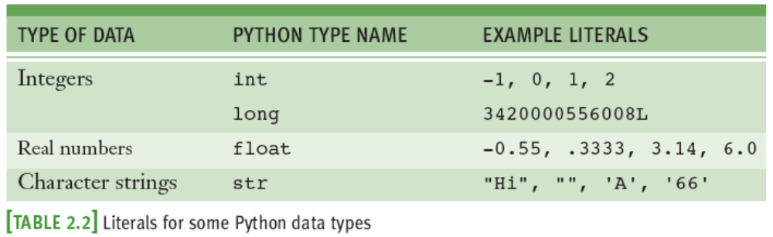
Data Types (continued)
Fundamentals of Python: From First Programs Through Data Structures

Slide 21
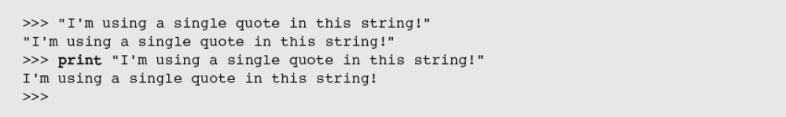
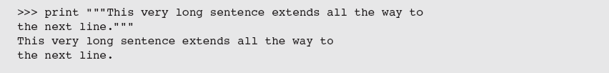

String Literals
In Python, a string literal is a sequence of characters enclosed in single or double quotation marks
'' and "" represent the empty string
Use ''' and """ for multi-line paragraphs
Fundamentals of Python: From First Programs Through Data Structures

Slide 22
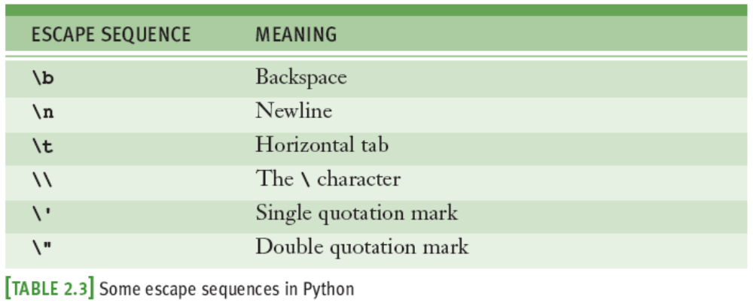
Escape Sequences
The newline character \n is called an escape sequence
Fundamentals of Python: From First Programs Through Data Structures

Slide 23
String Concatenation
You can join two or more strings to form a new string using the concatenation operator +
The * operator allows you to build a string by repeating another string a given number of times
Fundamentals of Python: From First Programs Through Data Structures

Slide 24
Variables and the Assignment Statement
A variable associates a name with a value
  Makes it easy to remember and use later in program
Variable naming rules:
  Reserved words cannot be used as variable names
    Examples: if, def, and import
  Name must begin with a letter or _
  Name can contain any number of letters, digits, or _
  Names are case sensitive
    Example: WEIGHT is different from weight
  Tip: use “camel casing” (Example: interestRate)
Fundamentals of Python: From First Programs Through Data Structures

Slide 25
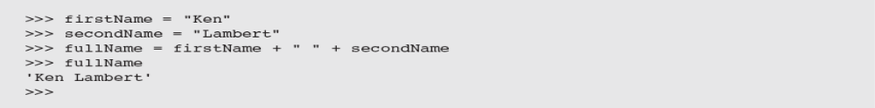
Variables and the Assignment Statement (continued)
Programmers use all uppercase letters for symbolic constants
  Examples: TAX_RATE and STANDARD_DEDUCTION
Variables receive initial values and can be reset to new values with an assignment statement
  <variable name> = <expression>
  Subsequent uses of the variable name in expressions are known as variable references
Fundamentals of Python: From First Programs Through Data Structures

Slide 26
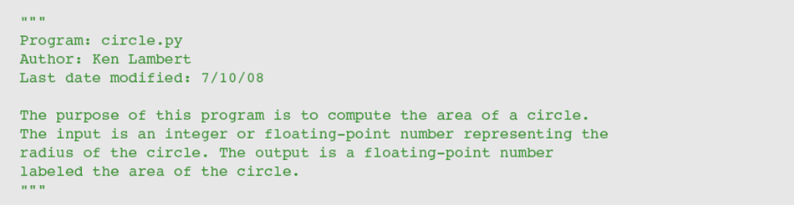
Program Comments and Docstrings
Docstring example:
End-of-line comment example:
Fundamentals of Python: From First Programs Through Data Structures

Slide 27
Numeric Data Types and Character Sets
The first applications of computers were to crunch numbers
The use of numbers in many applications is still very important
Fundamentals of Python: From First Programs Through Data Structures

Slide 28
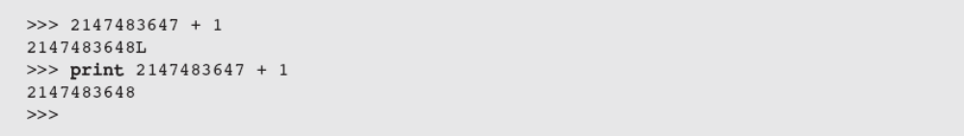
Integers and Long Integers
In real life, the range of integers is infinite
A computer’s memory places a limit on magnitude of the largest positive and negative integers
  Python’s int typical range: –2³¹ to 2³¹ – 1
Integer literals are written without commas
When value of integer exceeds int limits, Python automatically uses long data type to represent it
Fundamentals of Python: From First Programs Through Data Structures

Slide 29
Floating-Point Numbers
Python uses floating-point numbers to represent real numbers
Python’s float typical range: –10³⁰⁸ to 10³⁰⁸ and
Typical precision: 16 digits
Fundamentals of Python: From First Programs Through Data Structures

Slide 30
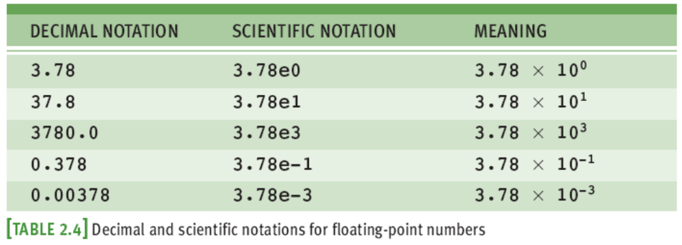
Floating-Point Numbers (continued)
Fundamentals of Python: From First Programs Through Data Structures

Slide 31
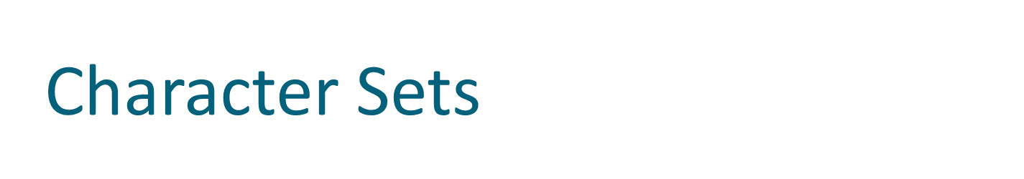
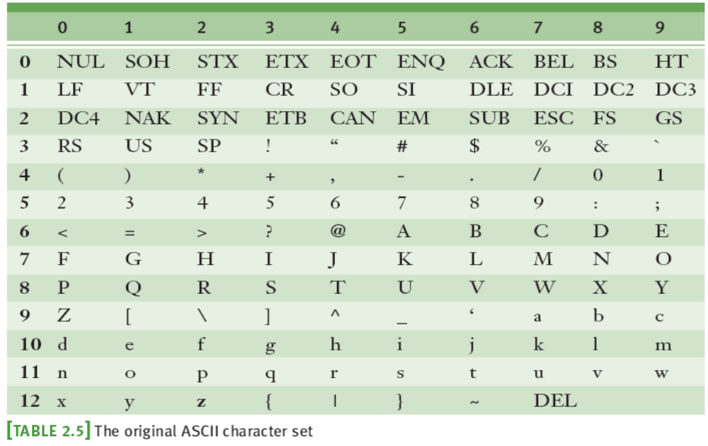
Fundamentals of Python: From First Programs Through Data Structures

Slide 32
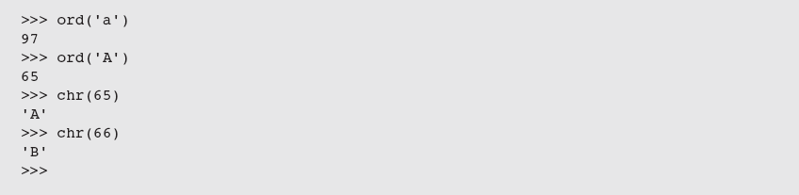
Character Sets (continued)
In Python, character literals look just like string literals and are of the string type
  They belong to several different character sets, among them the ASCII set and the Unicode set
ASCII character set maps to set of integers
ord and chr convert characters to and from ASCII
Fundamentals of Python: From First Programs Through Data Structures

Slide 33
Expressions
A literal evaluates to itself
A variable reference evaluates to the variable’s current value
Expressions provide easy way to perform operations on data values to produce other values
When entered at Python shell prompt, expression’s operands are evaluated and its operator is then applied to these values to compute the value of the expression
Fundamentals of Python: From First Programs Through Data Structures

Slide 34
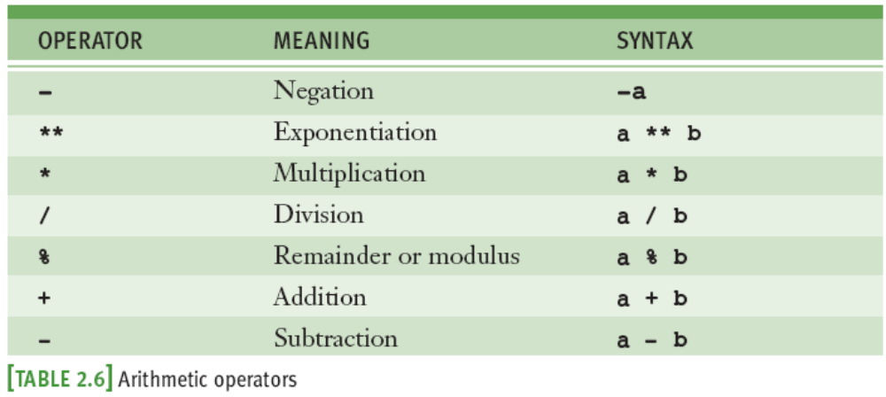
Arithmetic Expressions
An arithmetic expression consists of operands and operators combined in a manner that is already familiar to you from learning algebra
Fundamentals of Python: From First Programs Through Data Structures

Slide 35
Arithmetic Expressions (continued)
Precedence rules:
  ** has the highest precedence and is evaluated first
  Unary negation is evaluated next
  *, /, and % are evaluated before + and -
  + and - are evaluated before =
  With two exceptions, operations of equal precedence are left associative, so they are evaluated from left to right
    ** and = are right associative
  You can use () to change the order of evaluation
Fundamentals of Python: From First Programs Through Data Structures

Slide 36
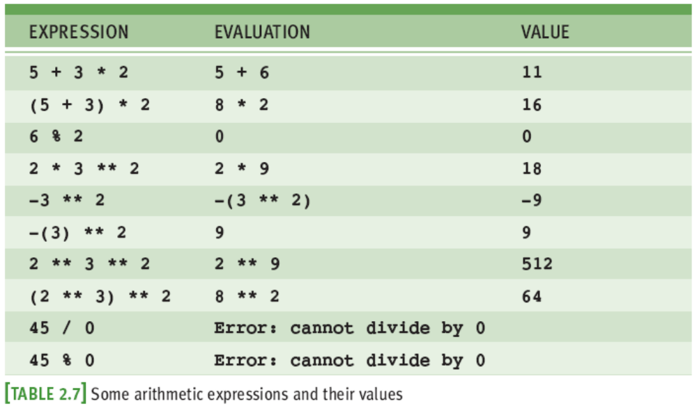
Arithmetic Expressions (continued)
45%0 is a semantic error
Fundamentals of Python: From First Programs Through Data Structures

Slide 37

Arithmetic Expressions (continued)
When both operands of an expression are of the same numeric type, resulting value is of that type
  Unless combination of two ints is large enough to produce a long
When each operand is of a different type, the resulting value is of the more general type
  Example: 3 / 4 is 0, whereas 3 / 4.0 is .75
For multi-line expressions, use a \
Fundamentals of Python: From First Programs Through Data Structures

Slide 38
Mixed-Mode Arithmetic and Type Conversions
Mixed-mode arithmetic involves integers and floating-point numbers:
  3.14 * 3 ** 2
Mixed-mode arithmetic can be problematic:
  3 / 2 * 5.0 yields 1 * 5.0, which yields 5.0
  3 / 2.0 * 5 yields 1.5 * 5, which yields 7.5
Solution:
  Place a .0 after the relevant integer literals
  Use a type conversion function with variables:
    3 / float(someInteger) * 5.0
Fundamentals of Python: From First Programs Through Data Structures

Slide 39
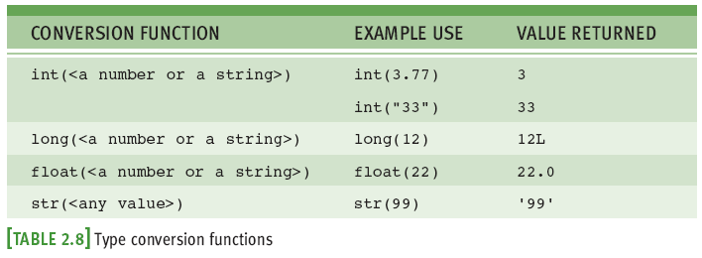
Mixed-Mode Arithmetic and Type Conversions (continued)
Fundamentals of Python: From First Programs Through Data Structures

Slide 40
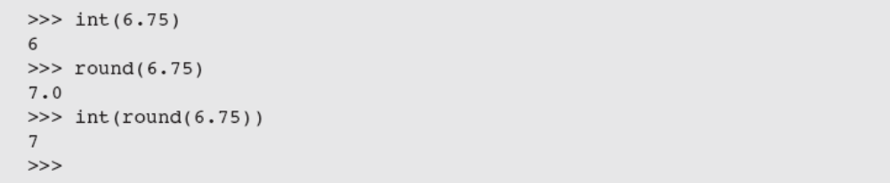
Mixed-Mode Arithmetic and Type Conversions (continued)
Note that the int function converts a float to an int by truncation, not by rounding
Fundamentals of Python: From First Programs Through Data Structures

Slide 41
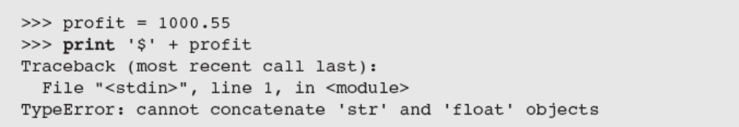
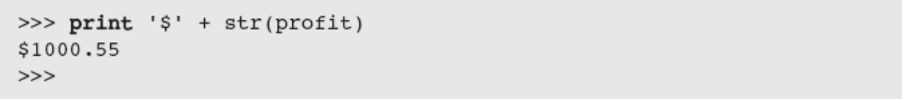
Mixed-Mode Arithmetic and Type Conversions (continued)
Type conversion also occurs in the construction of strings from numbers and other strings
Solution: use str function
Python is a strongly typed programming language
Fundamentals of Python: From First Programs Through Data Structures

Slide 42
Using Functions and Modules
Python includes many useful functions, which are organized in libraries of code called modules
Fundamentals of Python: From First Programs Through Data Structures

Slide 43
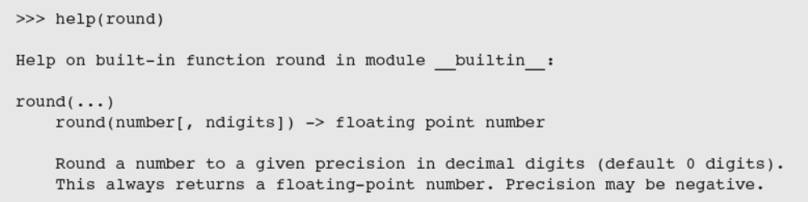
Calling Functions: Arguments and Return Values
A function is chunk of code that can be called by name to perform a task
Functions often require arguments or parameters
  Arguments may be optional or required
When function completes its task, it may return a value back to the part of the program that called it
Fundamentals of Python: From First Programs Through Data Structures

Slide 44
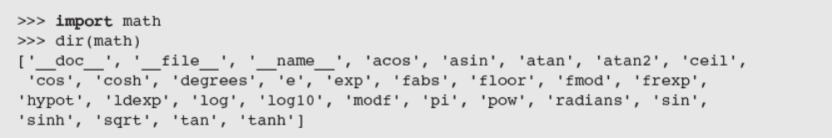
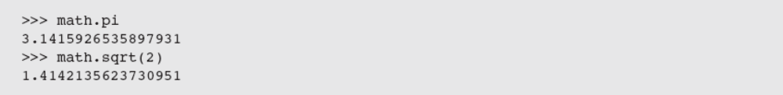
The math Module
To use a resource from a module, you write the name of a module as a qualifier, followed by a dot (.) and the name of the resource
  Example: math.pi
Fundamentals of Python: From First Programs Through Data Structures

Slide 45
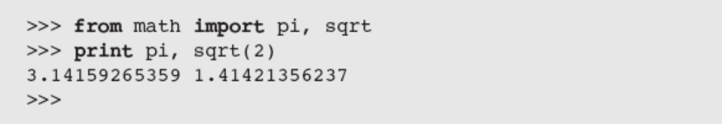
The math Module (continued)
You can avoid the use of the qualifier with each reference by importing the individual resources
You may import all of a module’s resources to use without the qualifier
  Example: from math import *
Fundamentals of Python: From First Programs Through Data Structures

Slide 46
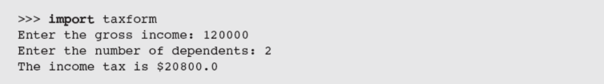
The Main Module
In the case study, earlier in this chapter, we showed how to write documentation for a Python script
To differentiate this script from the other modules in a program, we call it the main module
  Like any module, the main module can be imported
Fundamentals of Python: From First Programs Through Data Structures

Slide 47
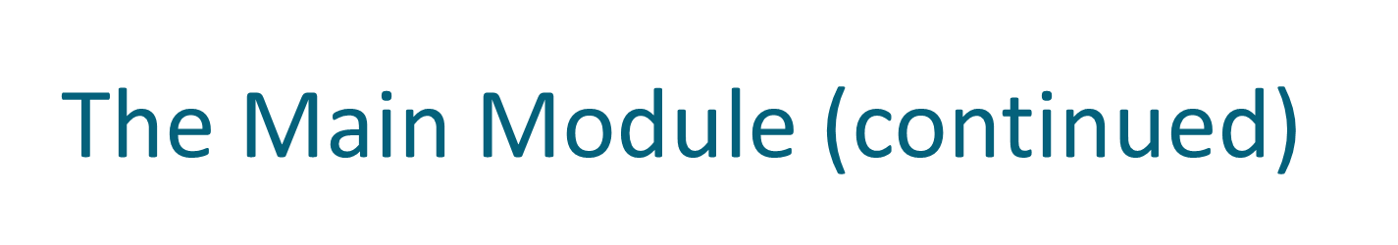
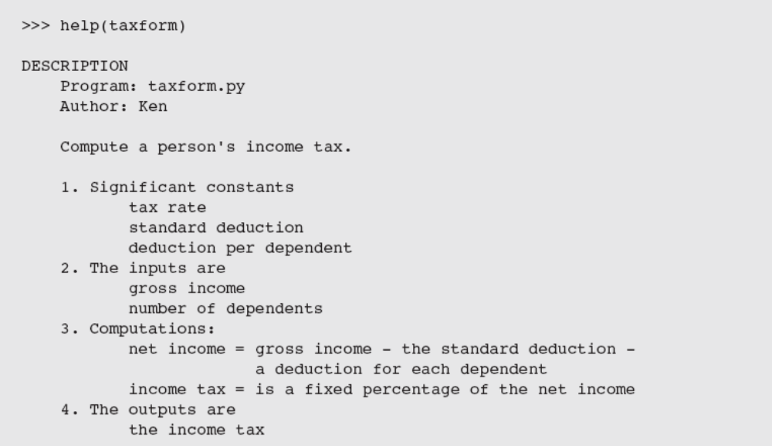
Fundamentals of Python: From First Programs Through Data Structures

Slide 48
Program Format and Structure
Start with comment with author’s name, purpose of program, and other relevant information
  In the form of a docstring
Then, include statements that:
  Import any modules needed by program
  Initialize important variables, suitably commented
  Prompt the user for input data and save the input data in variables
  Process the inputs to produce the results
  Display the results
Fundamentals of Python: From First Programs Through Data Structures

Slide 49
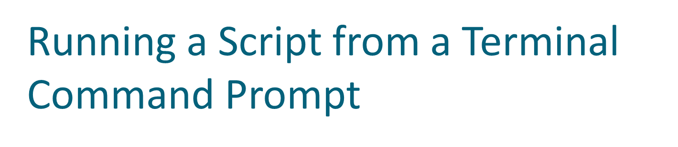
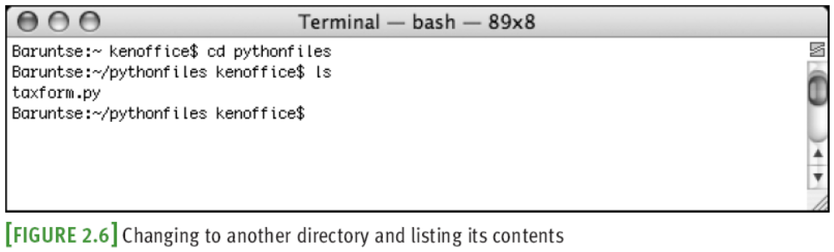
Fundamentals of Python: From First Programs Through Data Structures

Slide 50
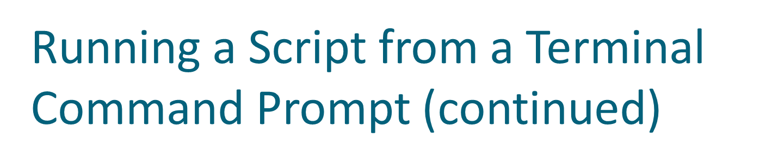
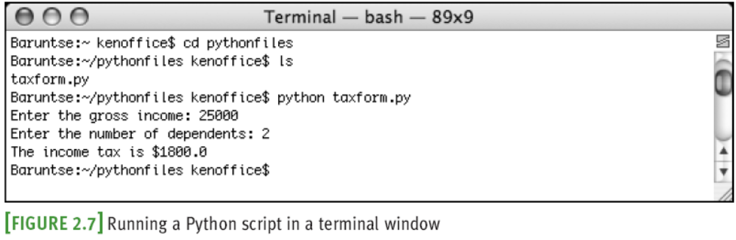
Fundamentals of Python: From First Programs Through Data Structures

Slide 51
Running a Script from a Terminal Command Prompt (continued)
Python installations enable you to launch Python scripts by double-clicking the files from the OS’s file browser
  May require .py file type to be set
  Fly-by-window problem: Window will close automatically
    Solution: Add an input statement at end of script that pauses until the user presses the enter or return key
Fundamentals of Python: From First Programs Through Data Structures

Slide 52
Summary
Waterfall model describes software development process in terms of several phases
Literals are data values that can appear in program
The string data type is used to represent text for input and output
Escape characters begin with backslash and represent special characters such as delete key
A docstring is string enclosed by triple quotation marks and provides program documentation
Fundamentals of Python: From First Programs Through Data Structures

Slide 53
Summary (continued)
Comments are pieces of code not evaluated by the interpreter but can be read by programmers to obtain information about a program
Variables are names that refer to values
Some data types: int, long, and float
Arithmetic operators are used to form arithmetic expressions
  Operators are ranked in precedence
Mixed-mode operations involve operands of different numeric data types
Fundamentals of Python: From First Programs Through Data Structures

Slide 54
Summary (continued)
A function call consists of a function’s name and its arguments or parameters
  May return a result value to the caller
Python is a strongly typed language
A module is a set of resources
  Can be imported
A semantic error occurs when the computer cannot perform the requested operation
A logic error produces incorrect results
Fundamentals of Python: From First Programs Through Data Structures

